Slide 1
Exploring an updated evaluation methodology at the example of an iron evaluation
Georg Schnabel
Nuclear Data Section
Division of Physical and Chemical Sciences NAPC
Department for Nuclear Sciences and Applications
IAEA, Vienna
CM on structural materials (INDEN)
17 December 2020

Slide 2
Outline
Nuclear data evaluation pipeline
Updated methodology at the example of Fe-56 between 800 keV and 5 MeV

Slide 3
Nuclear DATA evaluation pipeline (Fe-56)

Slide 4
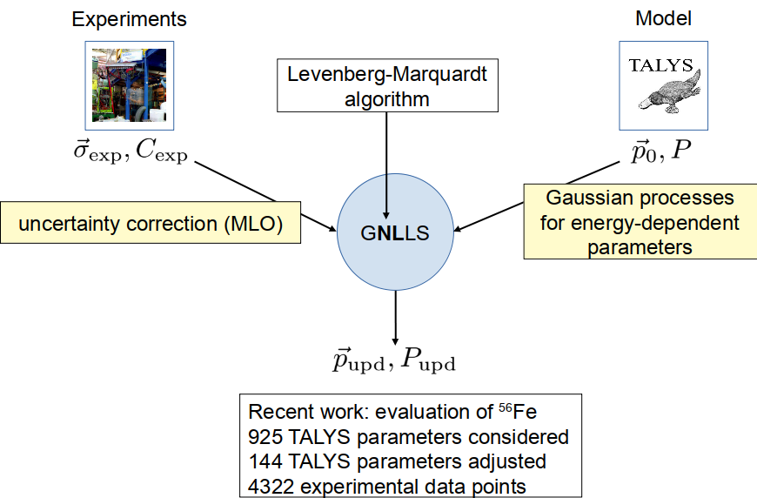
Pipeline overview
Conception and software implementation of a nuclear data evaluation pipeline arxiv:2009.00521

Slide 5
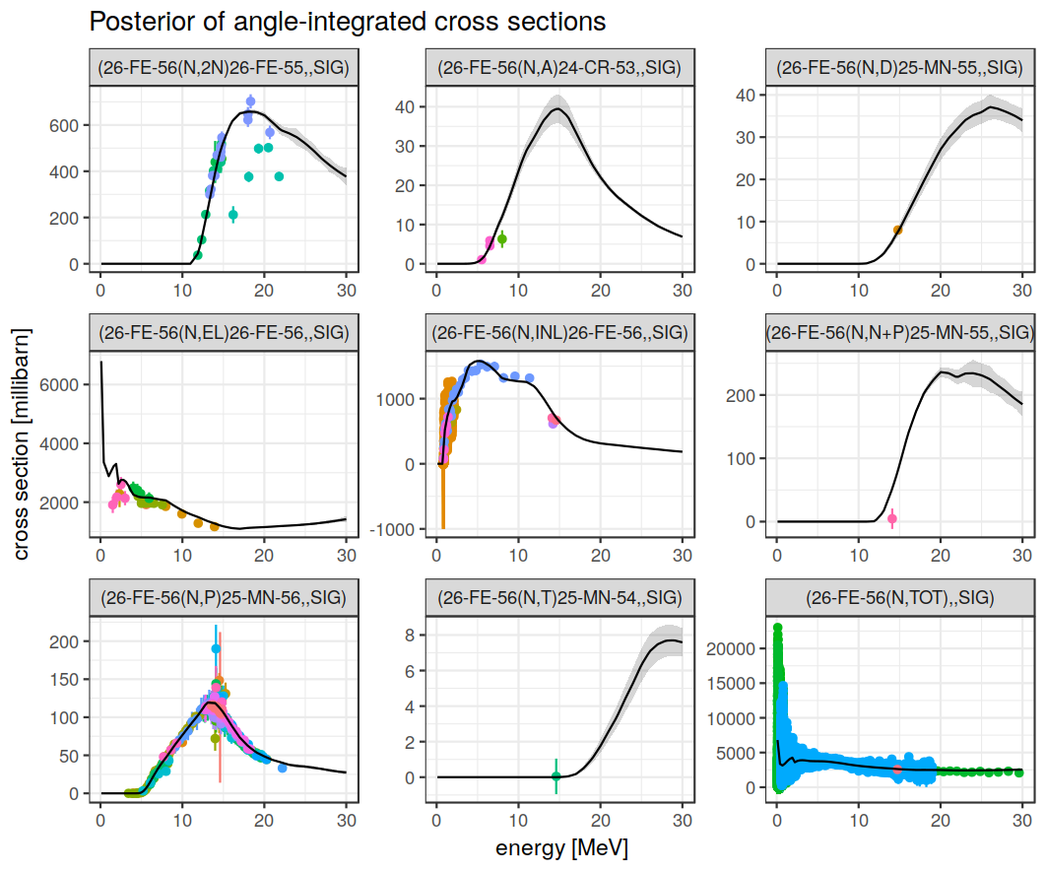
Experimental data and fit

Slide 6
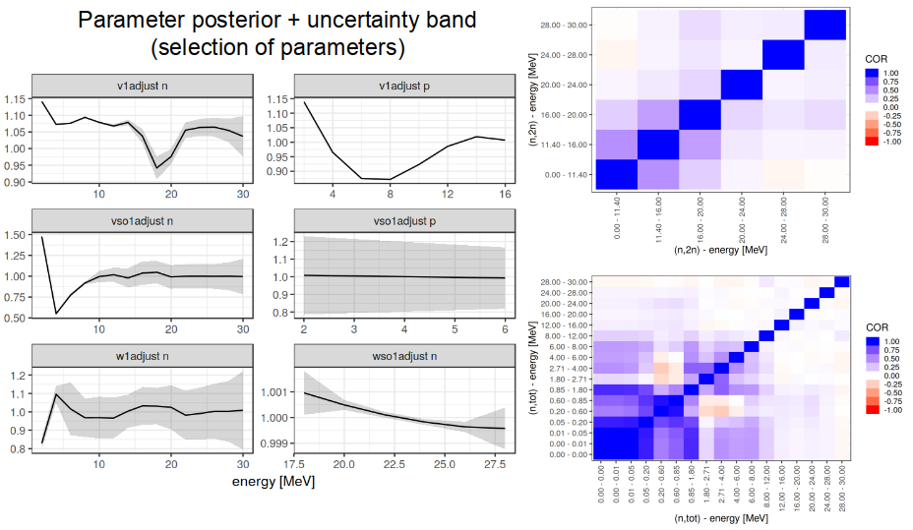
Energy-dependent parameters inside TALYS

Slide 7
Technical achievements
Deal efficiently with non-linear models
Use of large corpora of experimental data
Fitting of energy-dependent model parameters (and a lot of them)

Slide 8
Open issues
Energy-dependent parameters are not always enough to fit the data if model is not suited
Telltale signs: Too low uncertainties, lack of coherence between predictions and experiments
Energy region between 800 keV and 5 MeV of Fe-56 problematic for both R-matrix and optical models

Slide 9
updated methodology for fe-56 between 800 kev and 5 MeV

Slide 10
Key ideas
Do not use R-matrix nor optical models
Use a very flexible class of functions instead
Apply Bayesian inference to propagate information from experiments to constrain function class
Enforce important constraints (e.g., smoothness and sum rules); can be regarded as another piece of information provided to Bayesian inference procedure

Slide 11
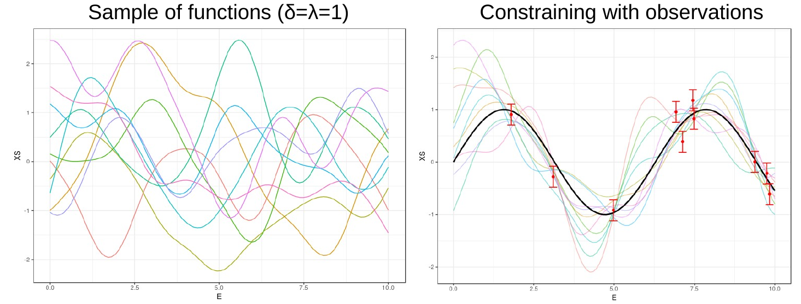
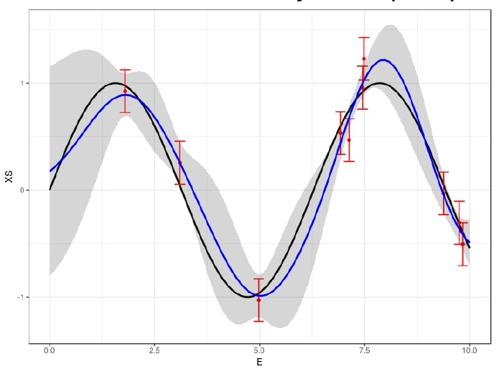
Gaussian processes (GP)

Slide 12
Combining GPs
Average
Cross section
High-res
fluctuations
+
True
Cross section
Transformations: resolution, doppler broadening, etc.
Experimental data

Slide 13
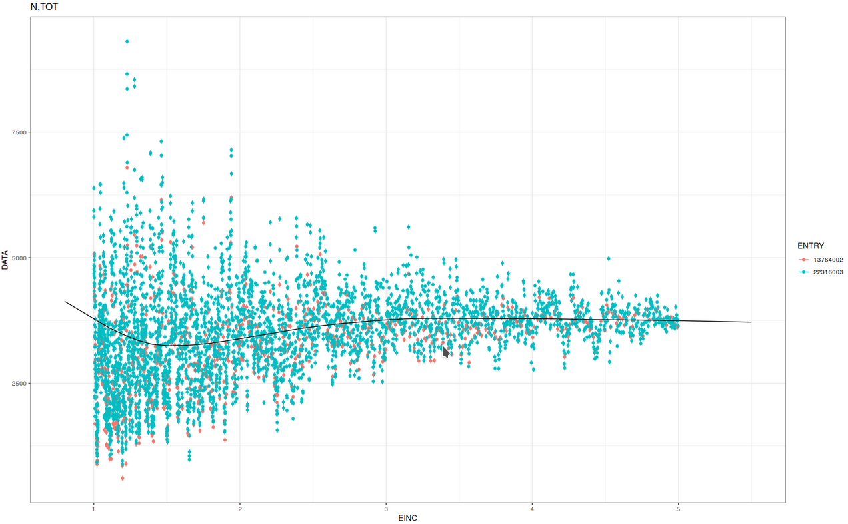
Example N,TOT (avg)

Slide 14
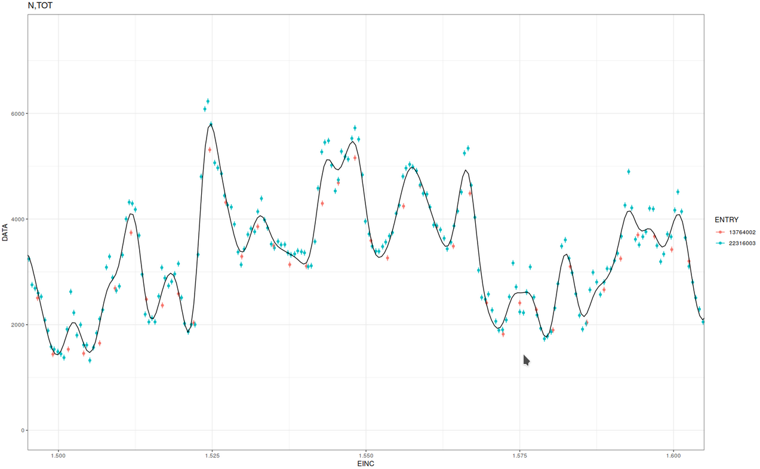
Example N,TOT (avg+hi-res)

Slide 15
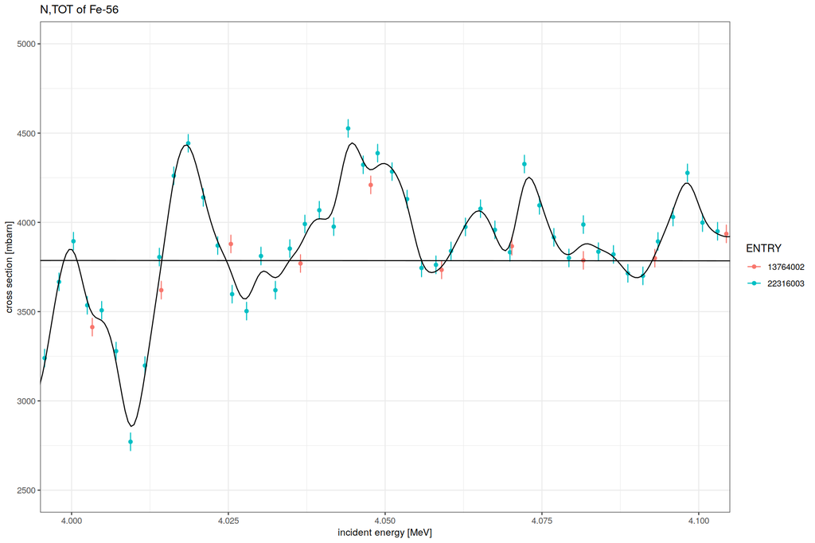
Example N,TOT (avg+hi-res)

Slide 16
Example N,INL (avg)

Slide 17
Example N,INL (avg+hires)

Slide 18
Example N,INL (avg+hires)

Slide 19
Example N,EL (avg, hires)

Slide 20
Some details
Mesh sizes (1-5 MeV):
Average cross section: 48 points
High-res fluctuations: 10k points
True cross section: 10k points
Experimental data (1-5 MeV):
N,TOT: 4671 (resolution: 1 keV)
N,INL: 440 (resolution: 1 keV)
N,EL: 10 (resolution: 300 keV)

Slide 21
Several channels
N,EL
N,INL
Average
Cross section
High-res
fluctuations
Average
Cross section
High-res
fluctuations
True cross section
True cross section
Experimental data
Experimental data
N,TOT
Average
Cross section
High-res
fluctuations
True cross section
Experimental data

Slide 22
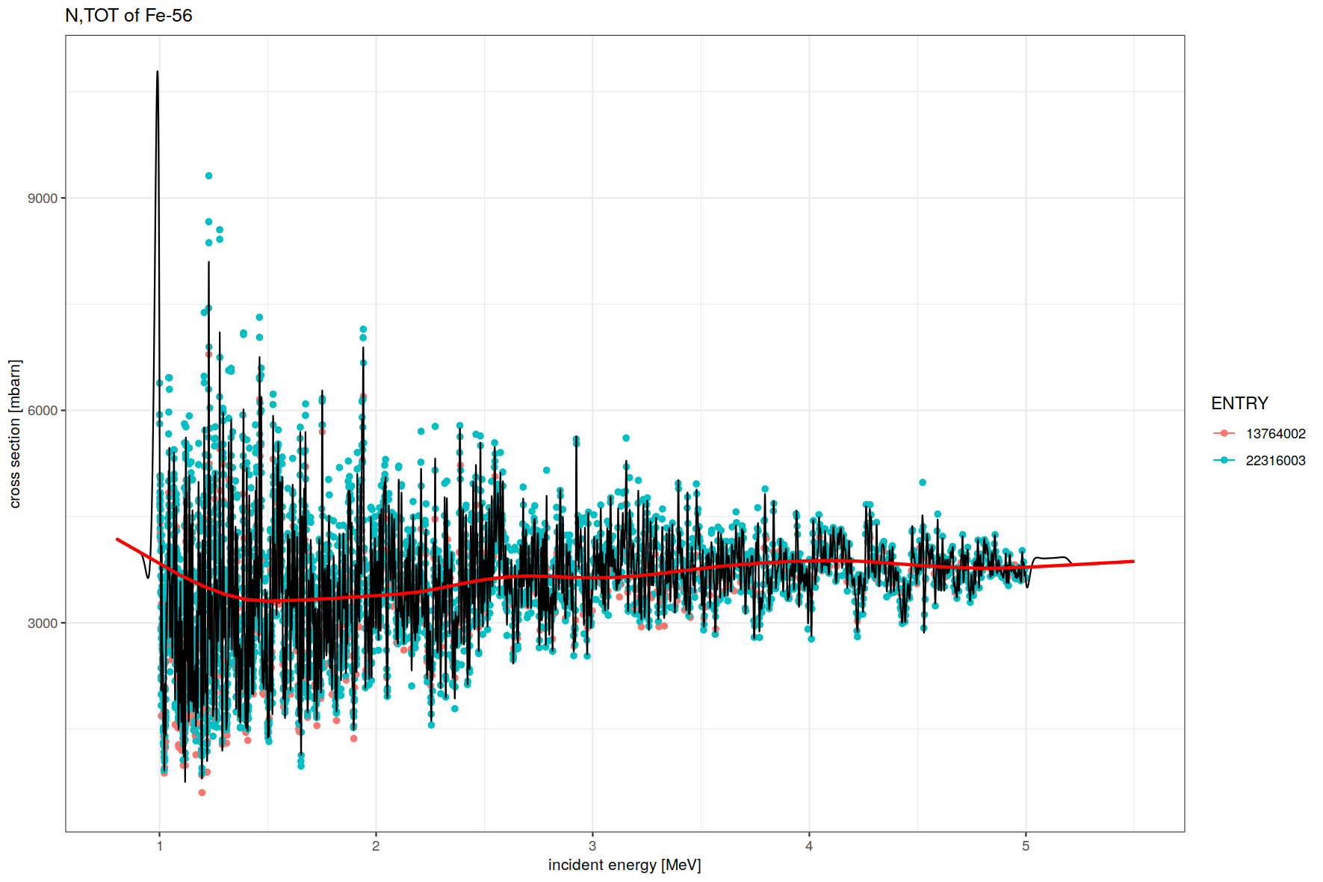
Example N,TOT

Slide 23
Example N,TOT (avg+hires)

Slide 24
Example N,TOT (avg+hires)

Slide 25
Example N,INL (avg)

Slide 26
Example N,INL (avg+hires)

Slide 27
Example N,INL (avg+hires)

Slide 28
Example N,EL (avg)

Slide 29
Example N,EL (avg+hires)

Slide 30
Summary
GPs can be used to fit both (and jointly) average cross sections and highly fluctuating cross sections
Tentative application on neutron-induced reactions of Fe-56 between 800 keV and 5 MeV
Some important features still need to be implemented, e.g., positivity constraints and proper handling of relative uncertainties to avoid PPP

